Slide 1
Chapter Six Overview
Applications of the Definite Integral in Geometry, Science, and Engineering

Slide 2
All graphics are attributed to:
Calculus,10/E by Howard Anton, Irl Bivens, and Stephen Davis Copyright © 2009 by John Wiley & Sons, Inc. All rights reserved.

Slide 3
Introduction
In the last chapter, the definite integral was introduced as the limit of Riemann sums and we used them to find area:
However, Riemann sums and definite integrals have applications that extend far beyond the area problem.
In this chapter, we will use Riemann sums and definite integrals to find volume and surface area of a solid, length of a plane curve, work done by a force, etc.
While these problems sound different, the calculations we will use will all follow a nearly identical procedure.

Slide 4
A Review of Riemann Sums
The distance between a and b is b-a.
Since we divided that distance into n subintervals, each is :
In each subinterval, draw a rectangle whose height is the value of the function f(x) at an arbitrarily selected point in the subinterval (a.k.a. x_{k}*) which gives f(x_{k}*).
Since the area of each rectangle is base * height, we get the formula you see on the right for each rectangle:
Area=
b*h = x * f(x_{k}*) = f(x_{k}*) x .

Slide 5
Review of Riemann Sums - continued
Remember, that was the area for each rectangle. We need to find the sum of the areas of all of the rectangles between a and b which is why we use sigma notation.
As we discussed in a previous section, the area estimate is more accurate with the more number of rectangles used. Therefore, we will let n approach infinity.

Slide 6
Area Between y = f(x) and y = g(x)
To find the area between two curves, we will divide the interval [a,b] into n subintervals (like we did in section 5.4) which subdivides the area region into n strips (see diagram below).

Slide 7
Area Between y = f(x) and y = g(x) continued
To find the height of each rectangle, subtract the function output values f(x_{k}*) – g(x_{k}*). The base is .
Therefore, the area of each strip is
base * height = * [f(x_{k}*) – g(x_{k}*)].
We do not want the area of one strip, we want the sum of the areas of all of the strips. That is why we need the sigma.
Also, we want the limit as the number of rectangles “n” increases to approach infinity, in order to get an accurate area.

Slide 8
Assuming One Curve is Always Above the Other

Slide 9
Summary of Steps Involved

Slide 10
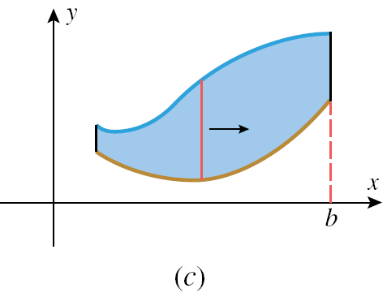
Picture of Steps Two and Three From Previous Slide:

Slide 11
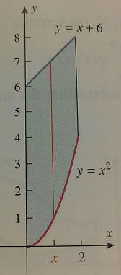
Straightforward Example

Slide 12
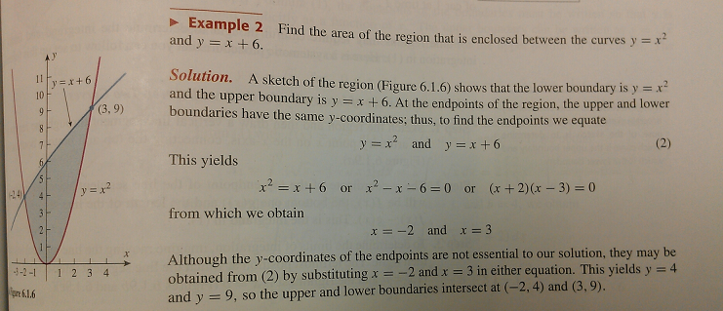
Sometimes, you will have to find the limits of integration by solving for the points of intersection first:
Then solve for the area as we did in the previous example:

Slide 13
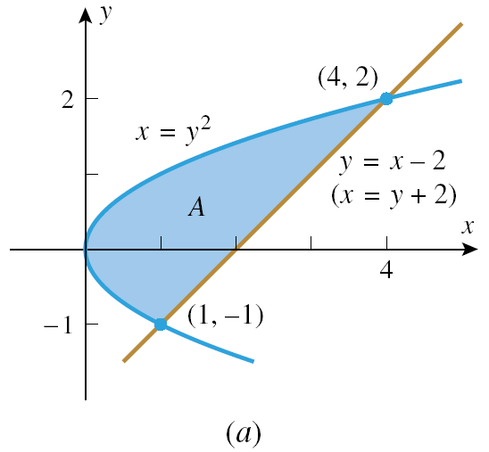
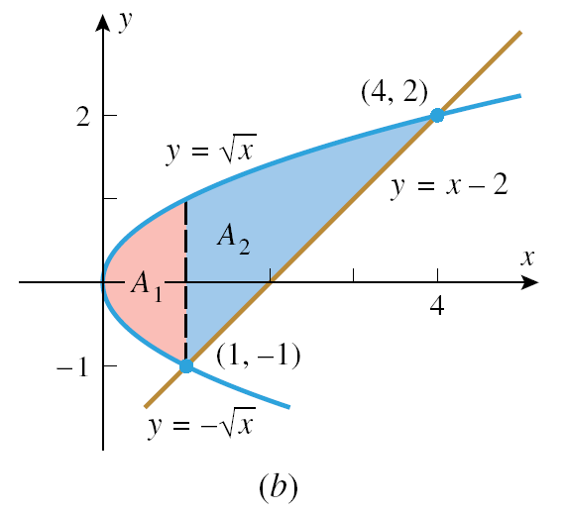
Inconsistent Boundaries
If you look at the area in figure (a), the upper and lower boundaries are not the same for the left portion of the graph as they are for the right portion.
On the left, the x = y² curve is the upper and lower boundary.
On the right, the x = y² curve is the upper boundary, but the line y = x – 2 is the lower boundary.
Therefore, in order to calculate the area using x as our variable, we must divide the region into two pieces, find the area of each, then add those areas to find the total area (see figure (b)).
See work on page 417 if interested.

Slide 14
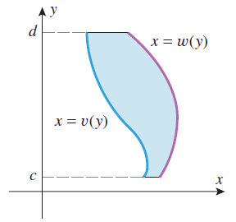
Reversing the Roles of x and y
Instead, we could reverse the roles of x and y to make it easier to find the area.
Solve for x in terms of y, find the lower and upper limits of integration in terms of y, and integrate with respect to y.

Slide 15
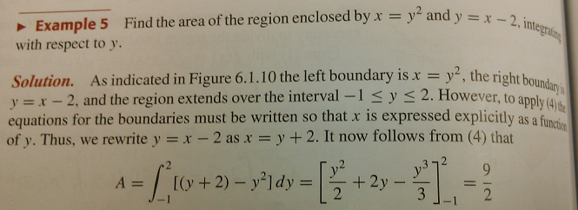
Reverse x and y to find the area on slide #13 instead of breaking into two sections.
You get exactly the same answer whether you break the area into two sections or if you reverse x and y.
This is a much easier and quicker calculation that we had to perform when we reversed x and y.
We avoided having to do two separate integrals and add our results.

Slide 16
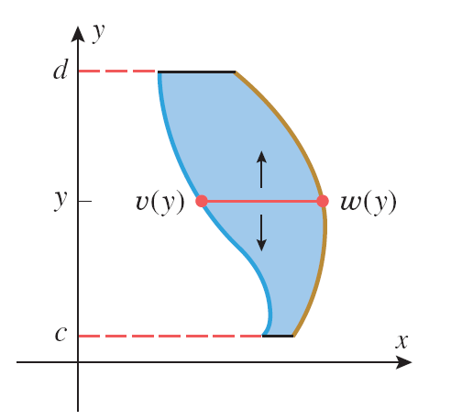
Formula and Picture for Reversing the Roles of x and y

Slide 17
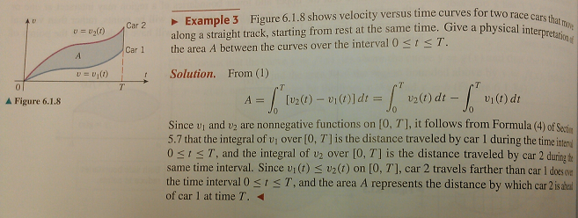
Application of Area Between Two Curves

Slide 18
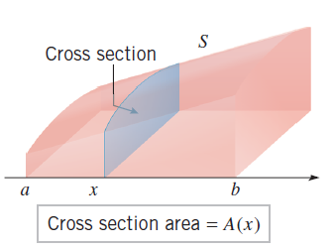
General Idea/Definition of Volume
In order to find volume we are first going to slice a three dimensional space (such as the one seen at the right) into infinitesimally narrow slices of area.
Then, find the area of each slice separately.
Next, find the sum of all of the areas (which will bring in the Sigma notation).
Calculate the limit as the number of slices approaches infinity to get an accurate measure of volume.

Slide 19
Which Area Formula?
The formula depends upon the shape of the cross-section. It could use a circle, square, triangle, etc.

Slide 21
Rotating Area using Discs to Find Volume
One of the simplest examples of a solid with congruent cross sections is
We are going to use all of the same ideas from Section 6.1 and more, so I am going to remind you of the process.
The difference is that after we find the area of each strip, we are going to rotate it around the x-axis, y-axis, or another line in order to find the resulting volume.

Slide 22
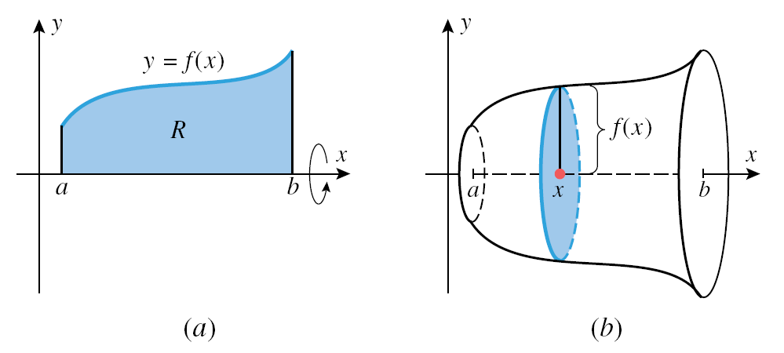
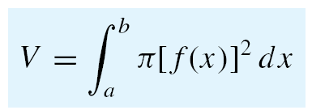

Slide 23
Rotating Area using Washers to Find Volume
We are going to use all of the same ideas from Section 6.1 and more, so I am going to remind you of the process.
The difference is that after we find the area of each strip, we are going to rotate it around the x-axis, y-axis, or another line in order to find the resulting volume.

Slide 24
Remember: Area Between y = f(x) and y = g(x)
To find the area between two curves, we will divide the interval [a,b] into n subintervals (like we did in section 5.4) which subdivides the area region into n strips (see diagram below).

Slide 25
Area Between y = f(x) and y = g(x) continued
To find the height of each rectangle, subtract the function output values f(x_{k}*) – g(x_{k}*). The base is .
Therefore, the area of each strip is base * height = * [f(x_{k}*) – g(x_{k}*)].
We do not want the area of one strip, we want the sum of the areas of all of the strips. That is why we need the sigma.
Also, we want the limit as the number of rectangles “n” increases to approach infinity, in order to get an accurate area.

Slide 26
Picture of Steps Two and Three From Previous Slide:

Slide 27
Volume
To find the height of each rectangular strip, subtract the function output values f(x_{k}*) – g(x_{k}*). The base is .
Therefore, the area of each strip is
base * height = * [f(x_{k}*) – g(x_{k}*)].
We do not want the area of one strip, we want the sum of the areas of all of the strips. That is why we need the sigma.
Also, we want the limit as the number of rectangles “n” increases to approach infinity, in order to get an accurate area.

Slide 30
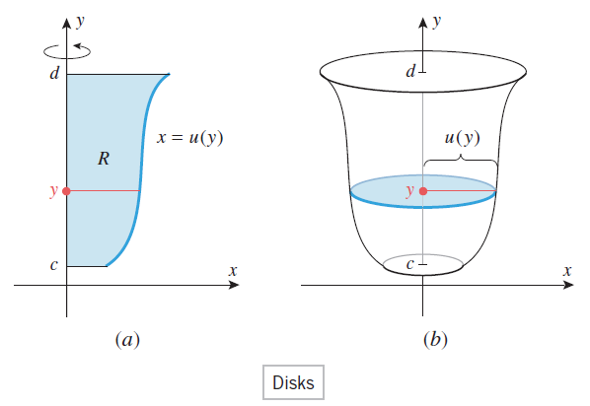

Slide 31
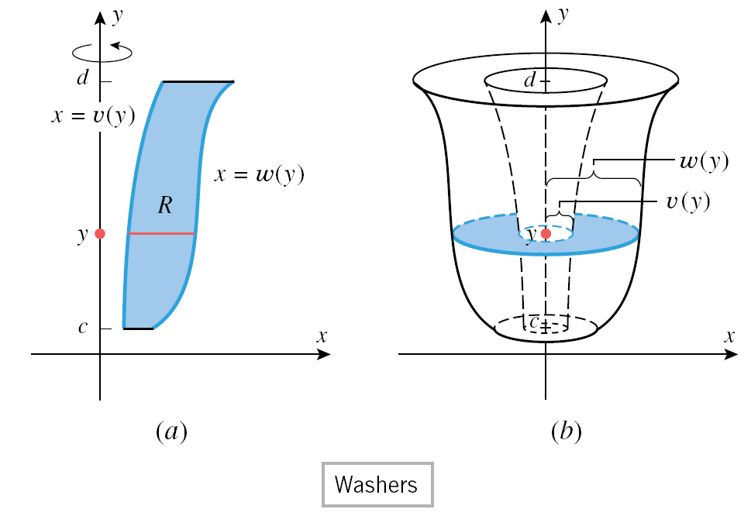

Slide 32
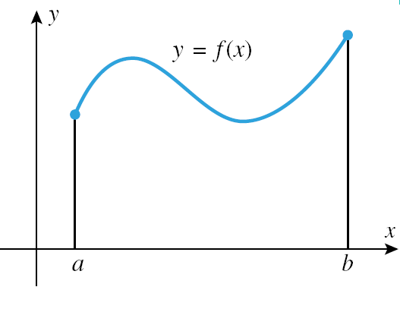

Slide 35
Introduction
In this section we will find the area of a surface that is generated by revolving a plane curve about a line.
It is very similar to section 6.4, therefore, the equation is very similar to that of arc length.
The difference is that we need to revolve it around a line like we did in sections 6.2 and 6.3.
Since we are only rotating the outside curve (not the area between it and the axis or line), each small section will be approximated by the circumference of the circle infinitesimally narrow width.

Slide 36
Examples Rotated about the x-axis

Slide 37
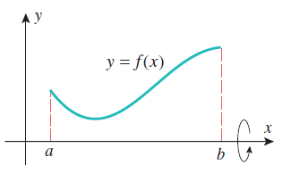
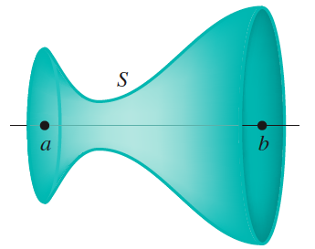
Around the x-axis

Slide 38
Break the Surface into Small Sections

Slide 39
Calculate Surface Area Using Riemann Sums
Each of the subintervals into which we broke the surface area on the previous slide (figure b) is called a frustum which is a portion of a right circular cone.
As we allow the number of subintervals to approach infinity, the width of each approaches zero.
Each subinterval gets closer and closer to resembling a circle who’s circumference is r.
We calculated the length of each subinterval in figure a on the previous slide last class using the distance formula.

Slide 40
Combine the Distance Formula and the Circumference
The arc length (distance) formula from last class and the circumference which represents the rotation around a line combine together to generate the following Riemann sum-like expression:
When we take the limit as the number of subintervals approaches infinity, this Riemann sum will give us the exact surface area.

Slide 41
Integral – when about the x-axis

Slide 42
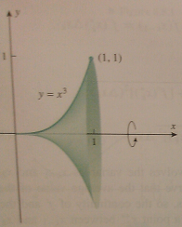
Example about the x-axis

Slide 43
Integral – when about the y-axis

Slide 44
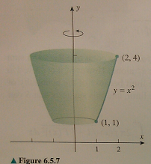
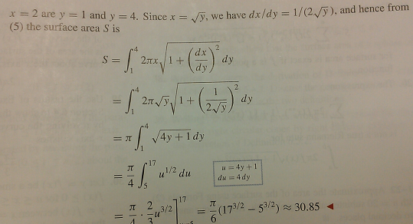
Example about the y-axis

Slide 45
Introduction
In this section we will use our integration skills to study some basic principles of “work”, which is one of the fundamental concepts in physics and engineering.
A simple example:
When you push a car that has run out of gas for a certain distance you are performing work and the effect of your work is to make the car move.
The energy of motion caused by the work is called the kinetic energy of the car.
There is a principle of physics called the work-energy relationship. We will barely touch on this principle.
Our main goal (on later slides) is to see how integration is related.

Slide 46
Examples of W = F * d
An object moves five feet along a line while subjected to a constant force of 100 pounds in its direction of motion.
The work done is W = F * d = 100 * 5 = 500 ft-lbs
An object moves 25 meters along a line while subjected to a constant force of four Newtons in its direction of motion.
The work done is W = F * d = 4*25 = 100 N-m
=100 Joules

Slide 47
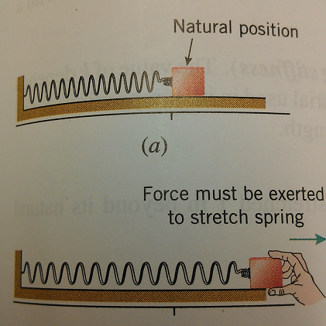
Work Done by a Variable Force Applied in the Direction of Motion
If we wanted to pull the block attached to the spring horizontally, then we would have to apply more and more force to the block to overcome the increasing force of the stretching spring.
We will break the interval of the stretch [a,b] into subintervals and approximate the work on each subinterval.
By adding the approximations to the work we will obtain a Riemann sum.
The limit of the Riemann sum as n increases will give us an integral for work W.

Slide 48
Integral for Work, W (with a Variable Force)

Slide 49
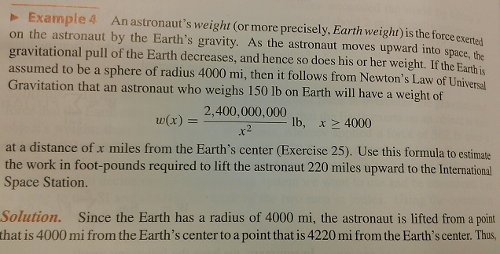
Example

Slide 50
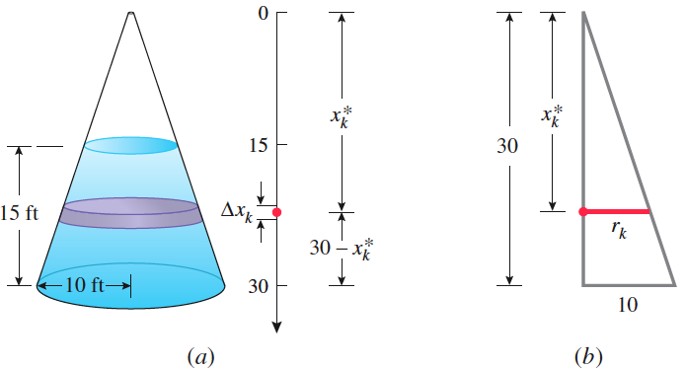
Calculating Work from Basic Principles Example
As you can see in the figure above right, we have a cone shaped (conical) container of radius 10 ft and height 30 ft. Suppose that this container is filled with water to a depth of 15 ft. How much work is required to pump all of the water out through the hole in the top of the container?
We will divide the water into thin layers, approximate the work required to move each layer to the top of the container and add them to obtain a Riemann sum.
The limit of the Riemann sum produces an integral for the total work.

Slide 51
Calculating Work from Basic Principles Example con’t
The volume of a cone is $\frac{1}{3}πr^{2}h$
By similar triangles the ratio of radius to height $\frac{r}{h}$ =$\frac{10}{30}$ =$\frac{1}{3}$
When these are combined with the weight density of water which is 62.4 pounds per cubic foot, we get the following Riemann sum and integral:

